Slide 1
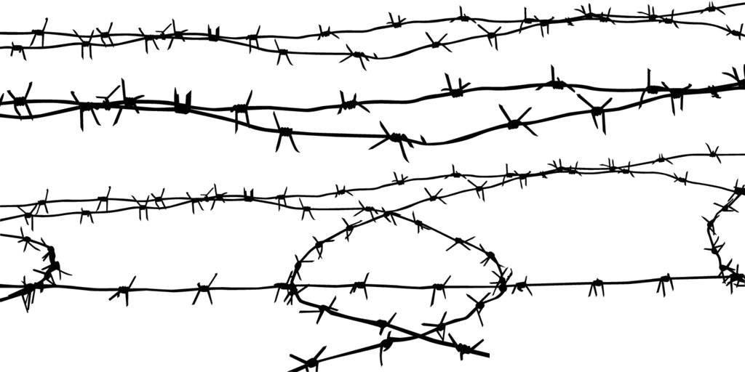

Modern Slavery
Complain.app
Hack’n’Lead - 2019
4*: Albin, Ashley, Kate, Masha
Notes:
You know the feeling when you come back tired from work …

Slide 2

How serious is the problem?
Take it easy, hard days may happen
You could consult your psychologist
Notes:
But In some cases this can be solved with just friendly talk

Slide 3


It can be hard to understand that things are going wrong
Take it easy, hard days may happen
You could consult your psychologist
Non-critical
Forward to NGO
Please contact <location> hotline:
Similar cases were successfully solved
show
Critical
+() ………….
Notes:
While in other cases this might be an indication of much more serious situation.

Slide 4


Based on person’s complaint suggest an action
Take it easy, hard days may happen
You could consult your psychologist
What bothered you today?
…|
Your location
Complain
Forward to NGO
Please contact <location> hotline:
Similar cases were successfully solved
show
+() ………….
Notes:
Example: For example, if the person does not have a passport, forced to work for 12 hours… she or he might feel unconfident, thnking they do not have another choice, or it is their fault and nobody will help them… or they just freeze from fear of taking an action …
It might be helpful to know that there are similar situations successfully solved in court.
Our app will be able to detect such situation and suggest appropriate actions, such as:….

Slide 5
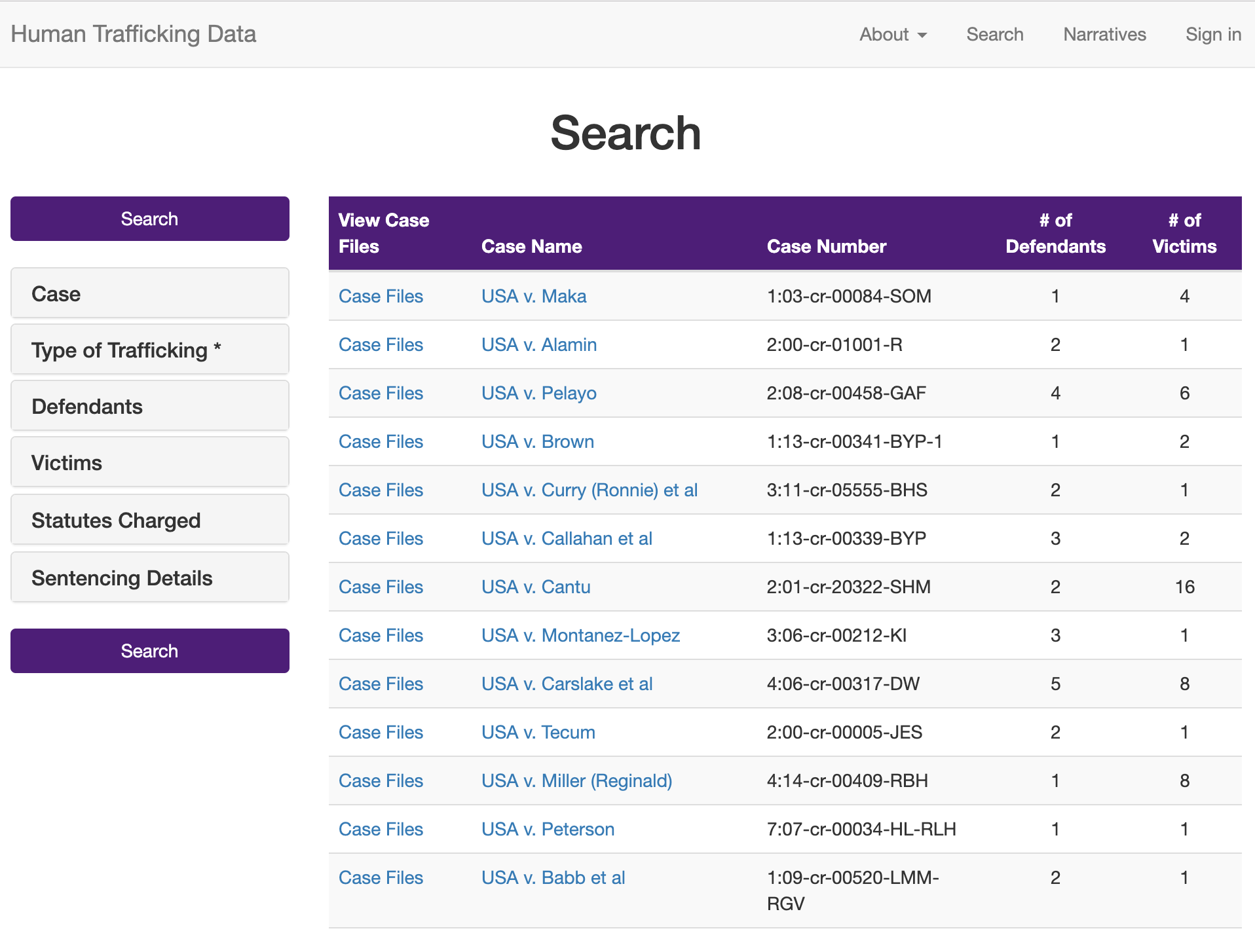
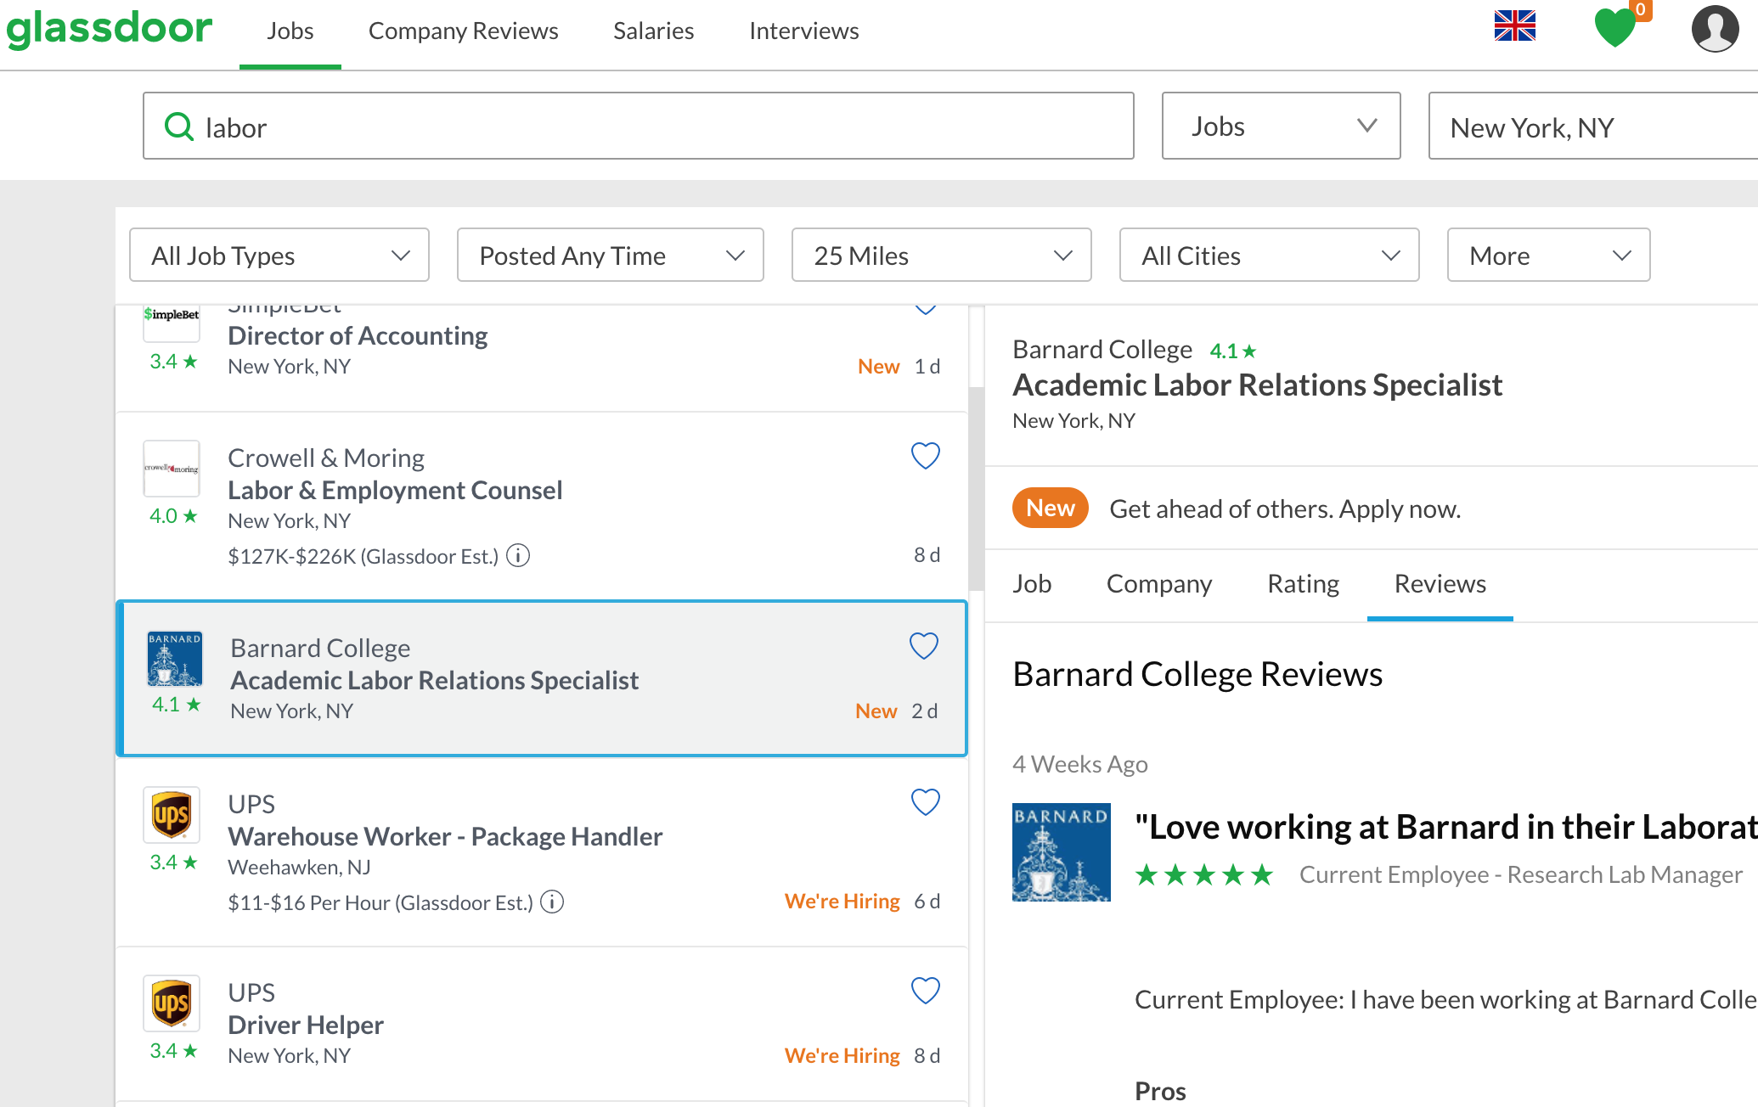
Data
Court cases
+
General complaints
+ Google real stories
Classes: Labor, Minor, Adult; not related
Notes:
There are hundreds of court cases related to modern slavery. There are hundreds of complaints for normal jobs too. We scraped this data for further analysis with NLP techniques.

Slide 6
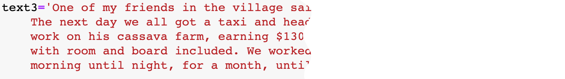



NLP models: Analysis
Approach:Doc2vec
Validation: TF-IDF
Notes:
Doc2vec is an unsupervised algorithm to generate vectors for sentence/paragraphs/documents.
Doc2vec: unsupervised -> generate vectors for sentence/paragraphs/documents.
tf–idf: numerical statistic -> reflect importance of a word to a document in a collection of document
or just collection

Slide 7
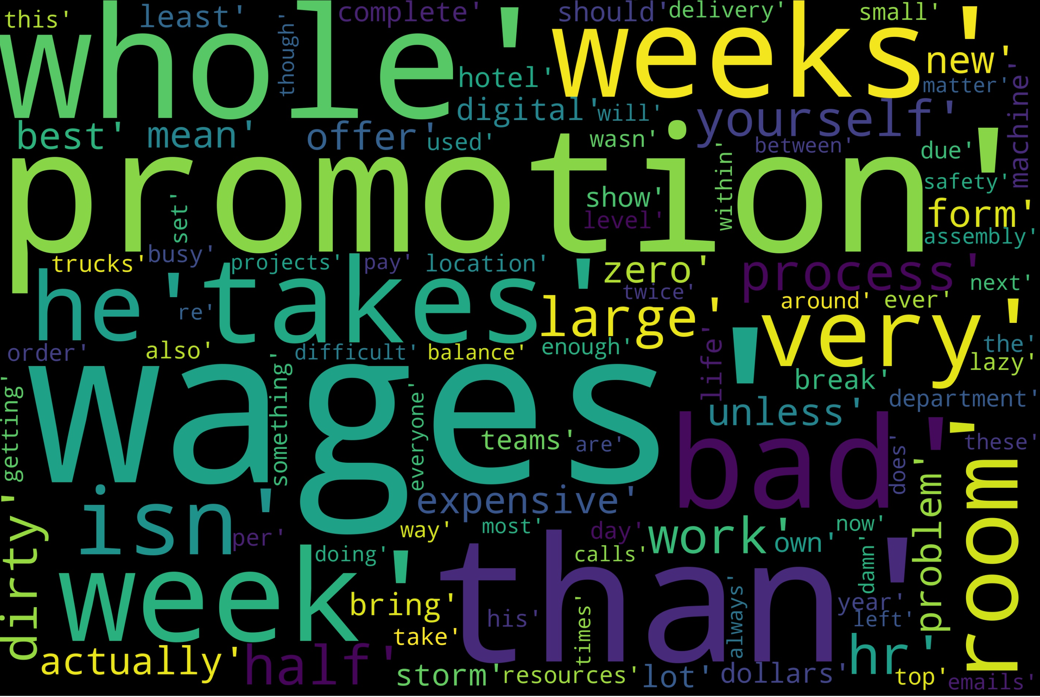
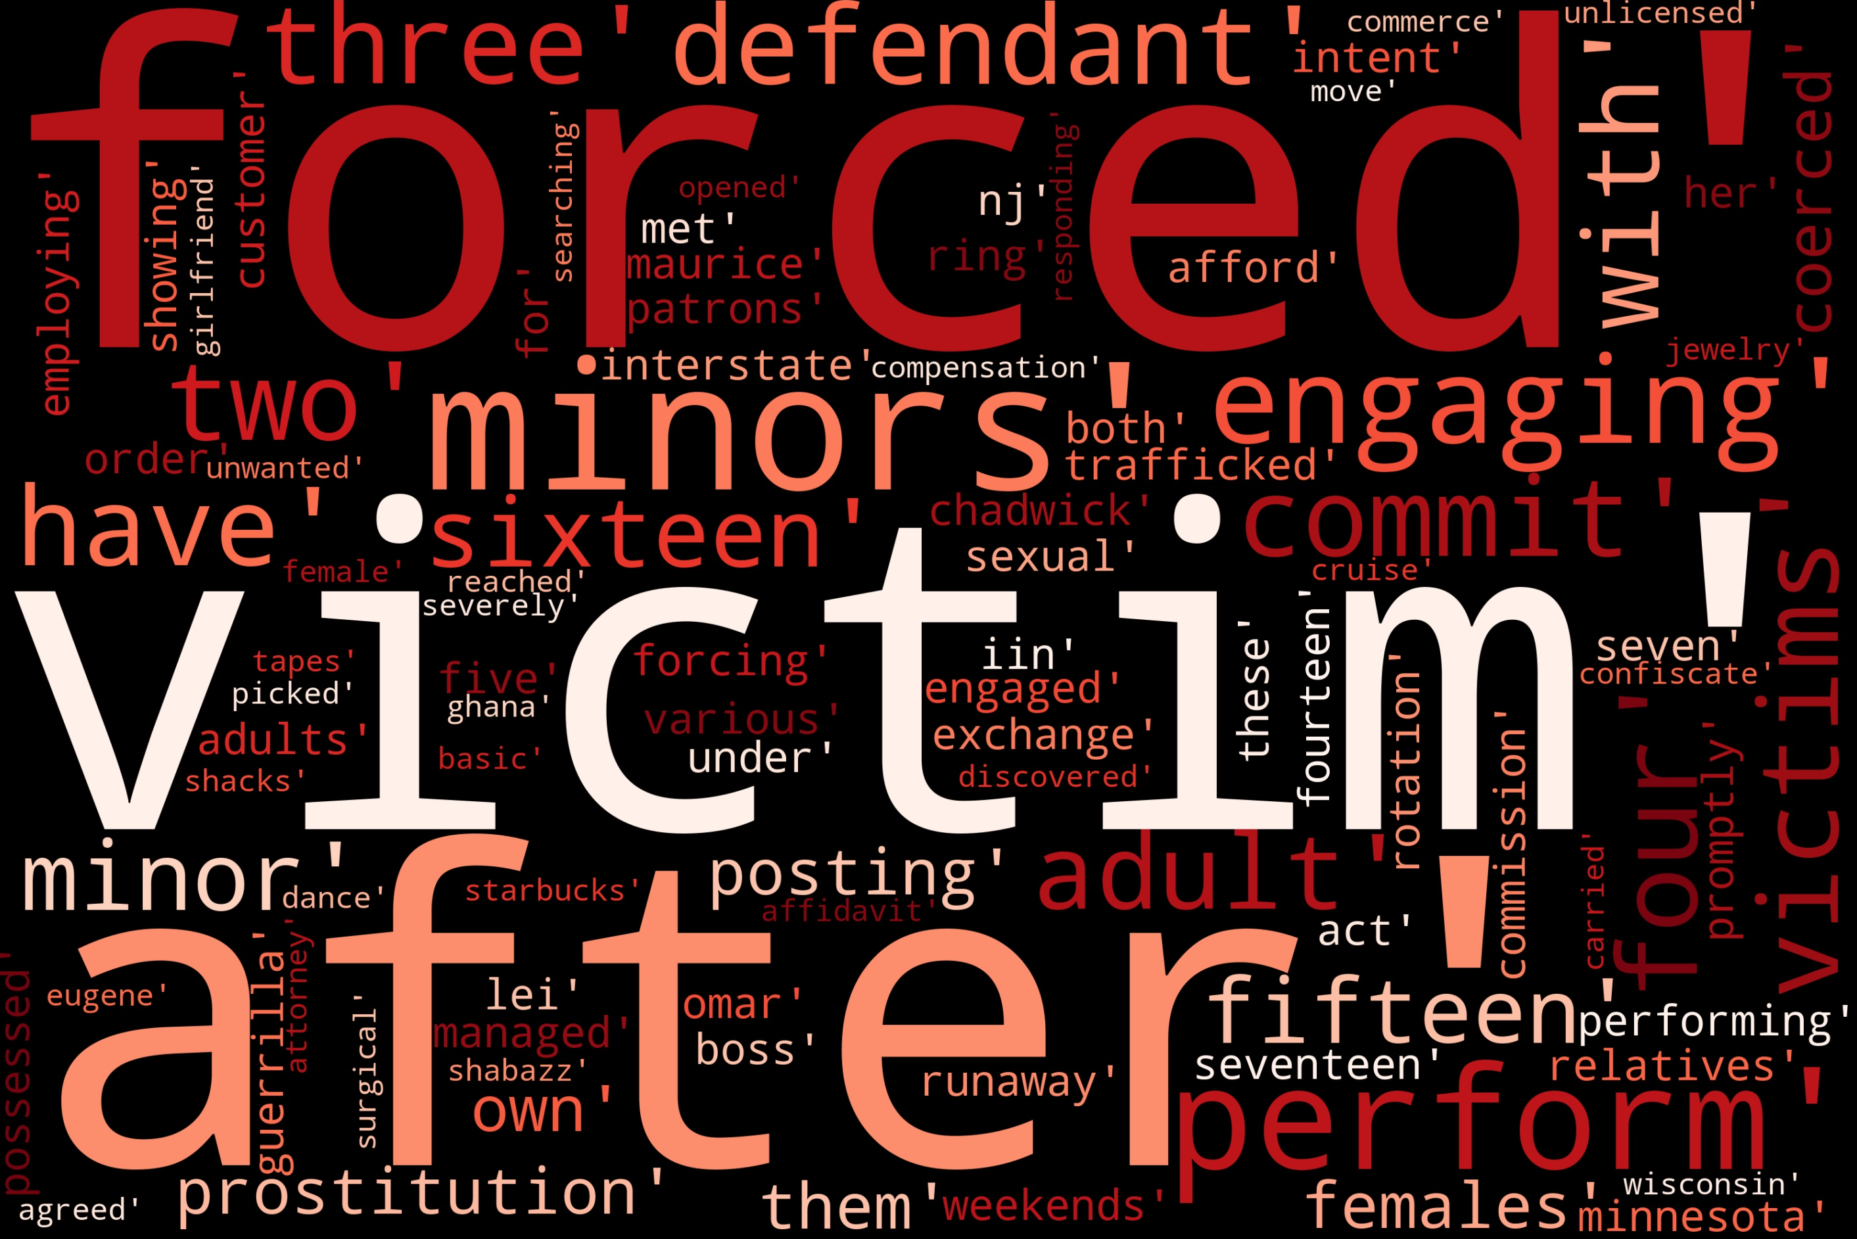
NLP models: Result
Everyday complains
Slave complains

Slide 8
Outlook
Data improvement:
Use real human complains
Extend to different countries
More features for the App:
Pre-install the App in the countries with high slavery rate
Validate job offers
Off-line functionality
Deploy it as filter for incoming calls to hotlines

Slide 9
Thank you for your attention!
https://github.com/maffka123/hack-n-lead2019

Slide 10
It can be hard to understand that things are going wrong
What bothered you today?
…|
Your location
Complain

